Slide 1
Open-CDMS
OpenWIS Association March 2016
Bruce Bannerman
a/Data Director – Australian Bureau of Meteorology ET–Climate Data Management Systems (Co-Chair) IPET–Metadata and Data Representation Development (CCl Representative) Implementation Coordination Team – Climate Services Information System (Member) Open Geospatial Consortium – Technical Committee (Voting member) World Wide Web Consortium – Spatial Data on the Web Working Group

Slide 2
galvanise action towards a step change in global climate data management
Consider:
“An important point to remember is that the most important stakeholders for our data have not been born yet and we are custodians of this data for their future use."
Statement attributed to:
Dr Blair Trewin Bureau of Meteorology, Australia

Slide 3
Problem to be addressed
Effective whole of life-cycle management of climate data
Consistent management of our data
Integrated Observations, Derived Data, etc
Understanding the context of our data
Climate metadata (Obs, Discovery, Provenance)
Intellectual Property (what can we do with it)
Effective integration of 3rd Party Data
Information security with audit trail
Consistent functionality
Data models, algorithms, data delivery, etc.
Available widely for WMO Community use

Slide 4
Current Situation

Slide 5
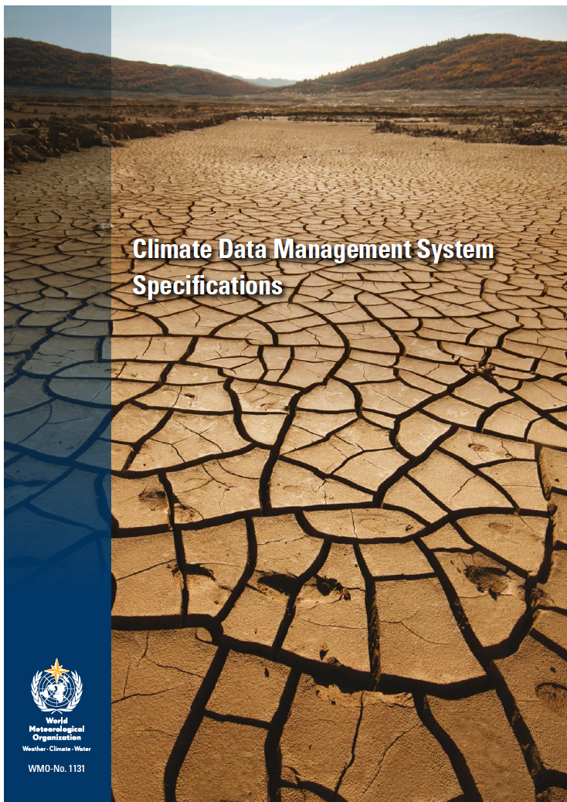
WMO #1131 CDMS Specifications
CDMS Spec Establishes a framework describing functionality required in a CDMS
Defines requirements for Climate Data Management Systems
Requirements are defined as a set of inter-related ‘components’

Slide 6
WMO 1131
Specifications intended to support Developing and Developed countries
Components are classified:
Required (mandatory)
Recommended (best practice)
Optional (more advanced)
Classification is a guide to NMHS on what functionality to implement:
What can NMHS afford to maintain for the long term?

Slide 7
Existing CDMS
Typically black-box systems
Functionality hidden
Without clearly defined requirements
Inconsistent capability between systems that call themselves a CDMS
Often poorly funded and maintained
Do not meet the next generation requirements of WMO #1131

Slide 8
NMHS
Many NMHS:
do not have a CDMS
Maintain Data using spread sheets
have multiple CDMS
Data spread across several NMHS
have CDMS that are at end-of-life
All NMHS:
Need investment to meet the next generation requirements of WMO #1131

Slide 9
WMO #1131 CDMS Specification
Quick Tour

Slide 10
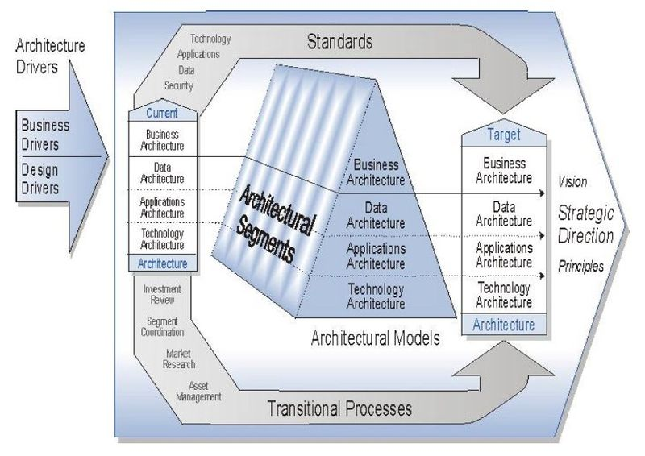
Defining the Future State
Diagram source: http://en.wikipedia.org/wiki/File:Structure_of_the_FEAF_Components.jpg

Slide 11
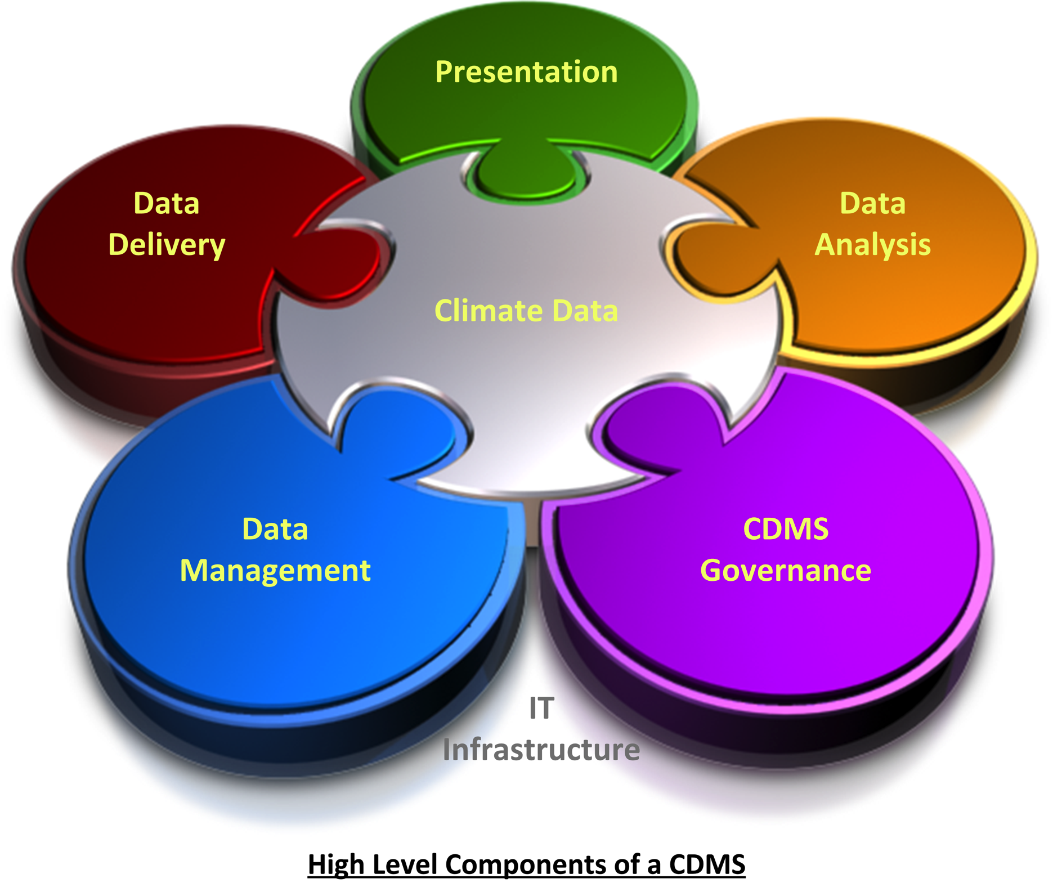
High Level CDMS Components

Slide 12
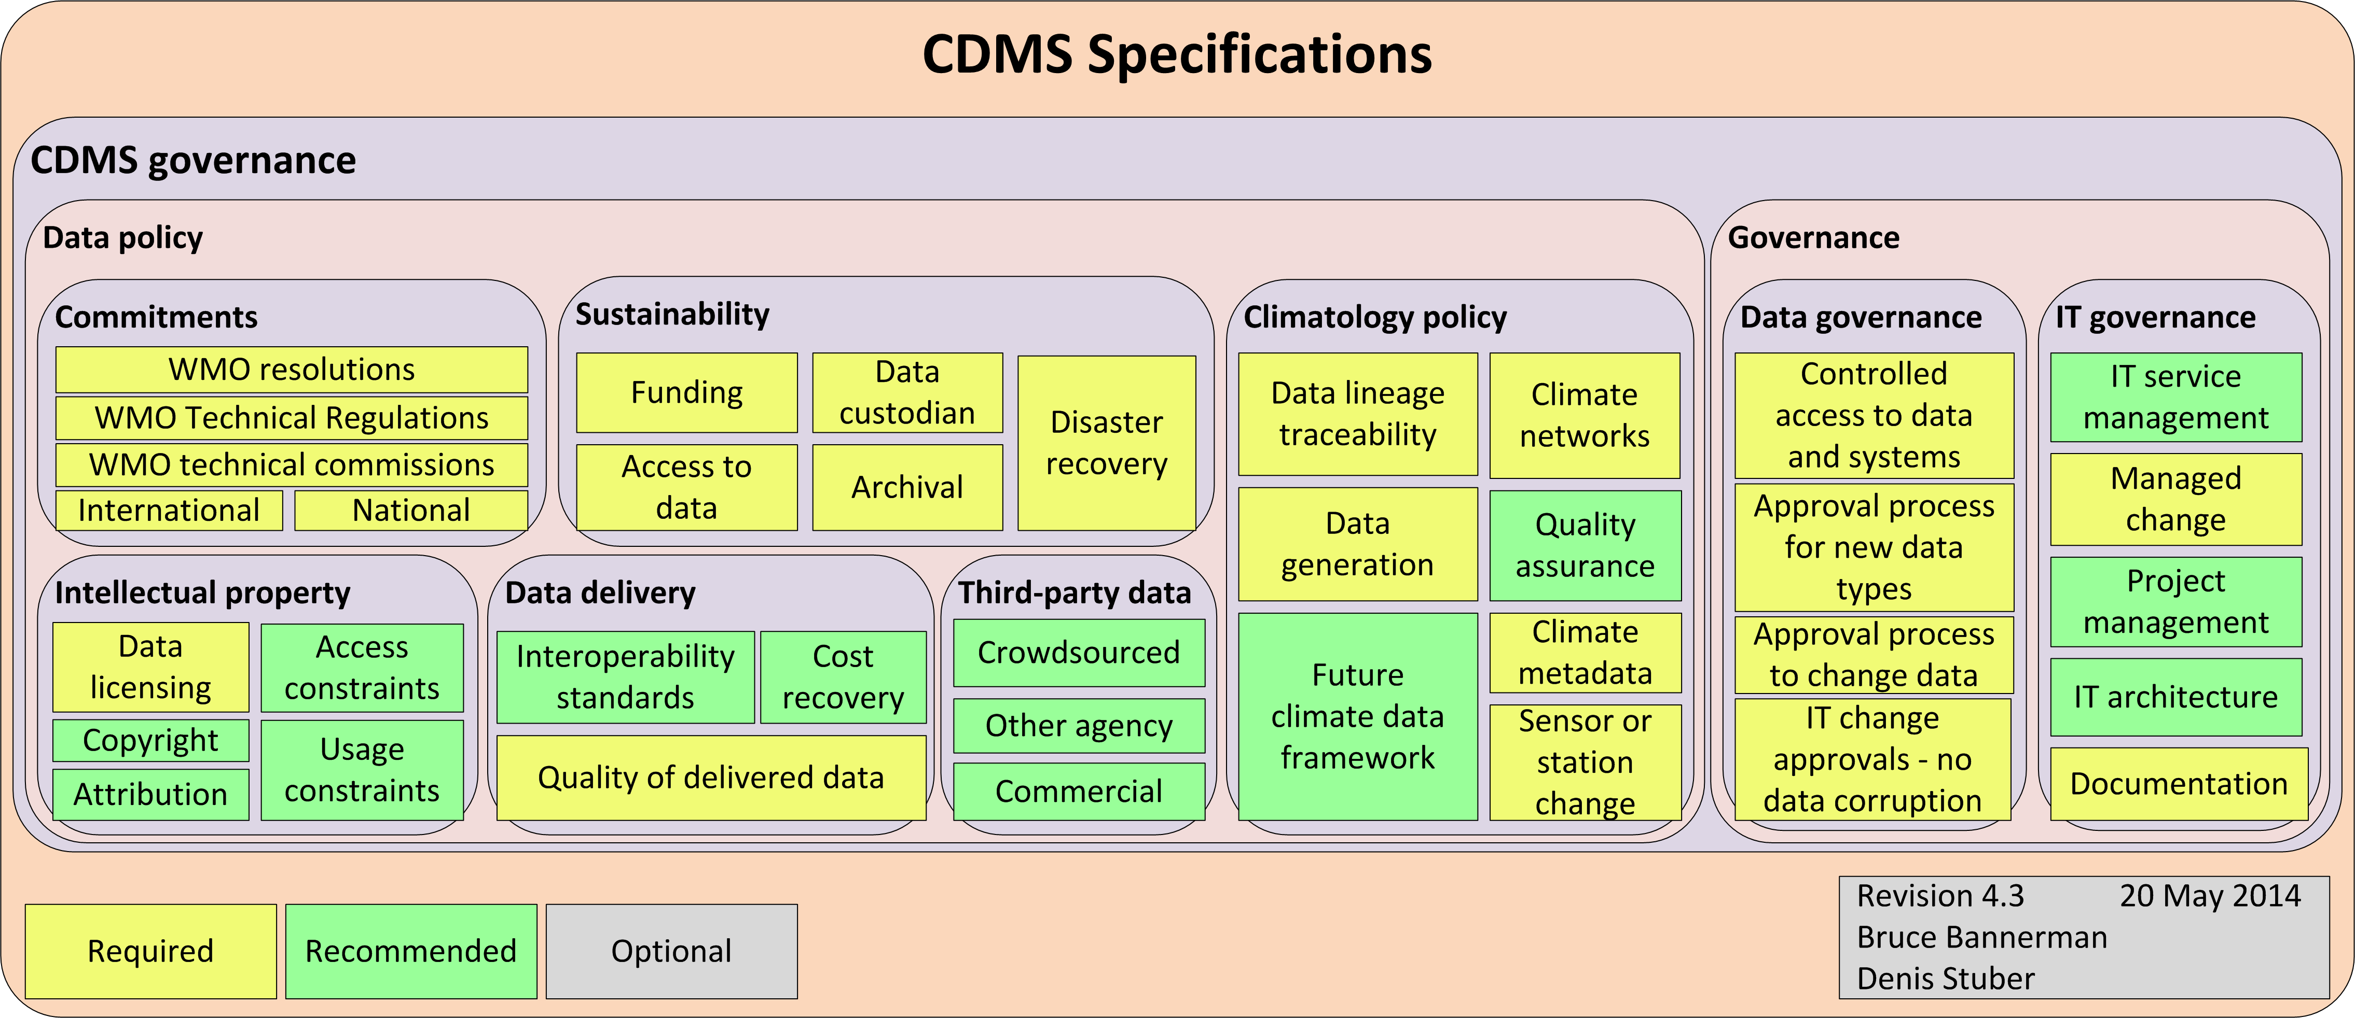
CDMS Governance

Slide 13
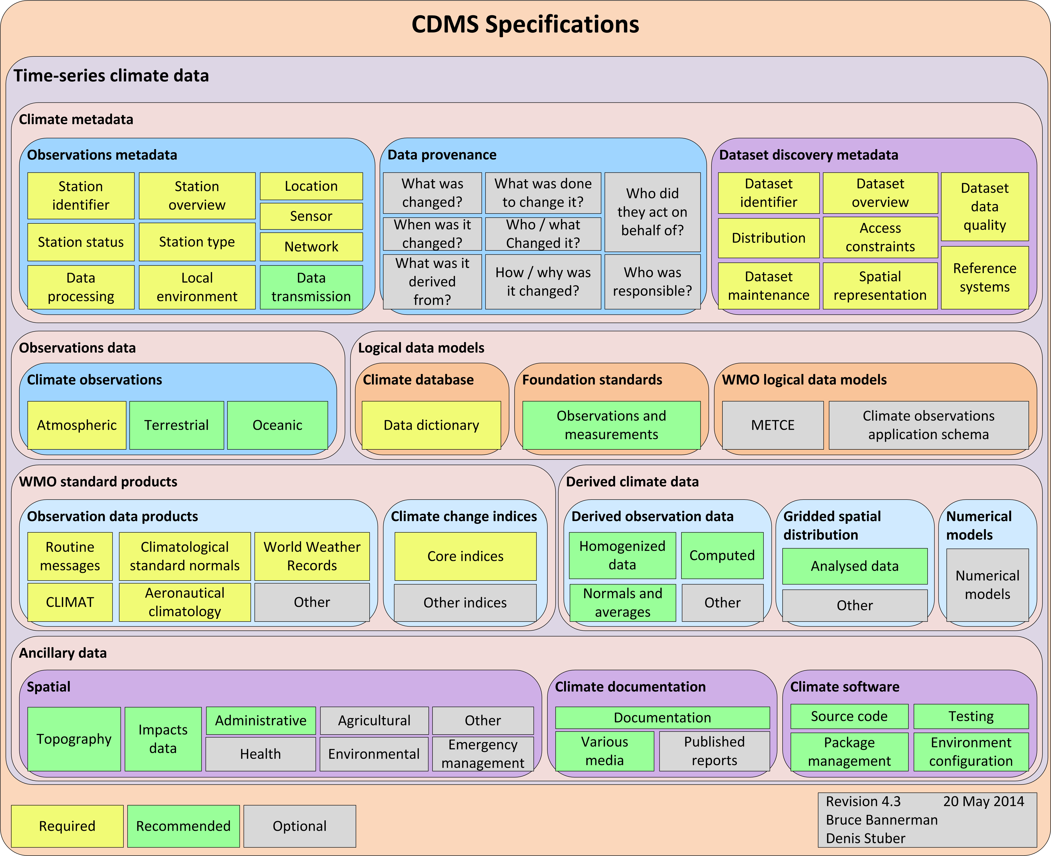
Time-series Climate Data

Slide 14
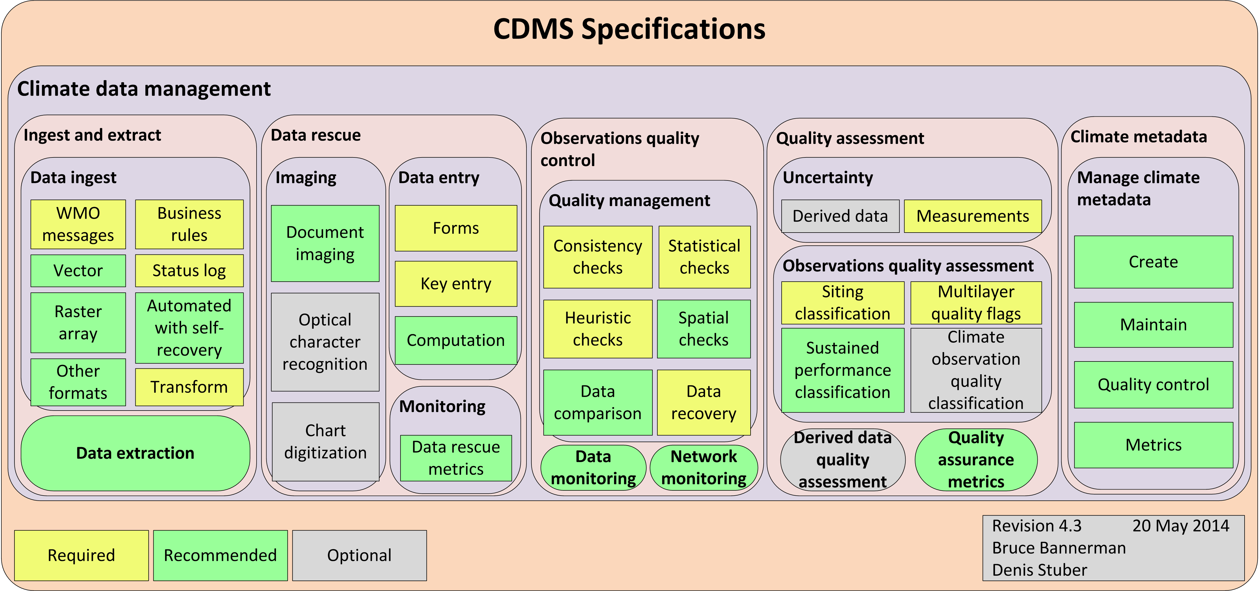
Climate Data Management

Slide 15
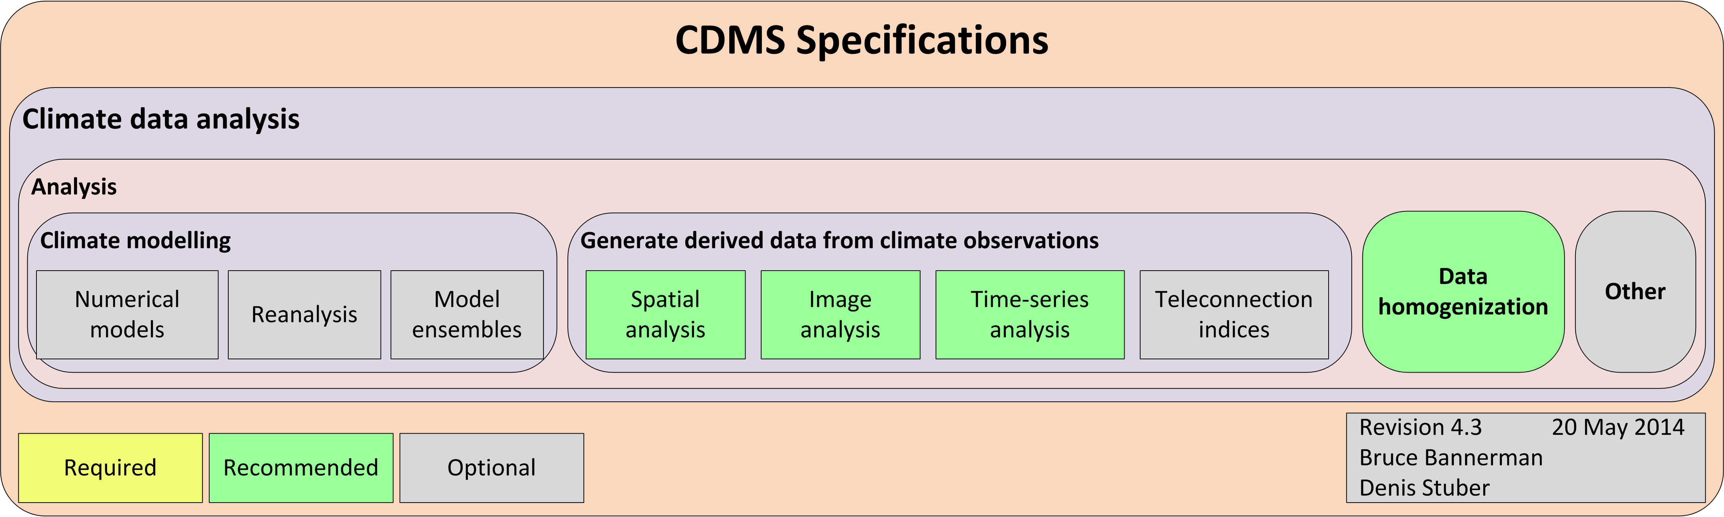
Climate Data Analysis

Slide 16
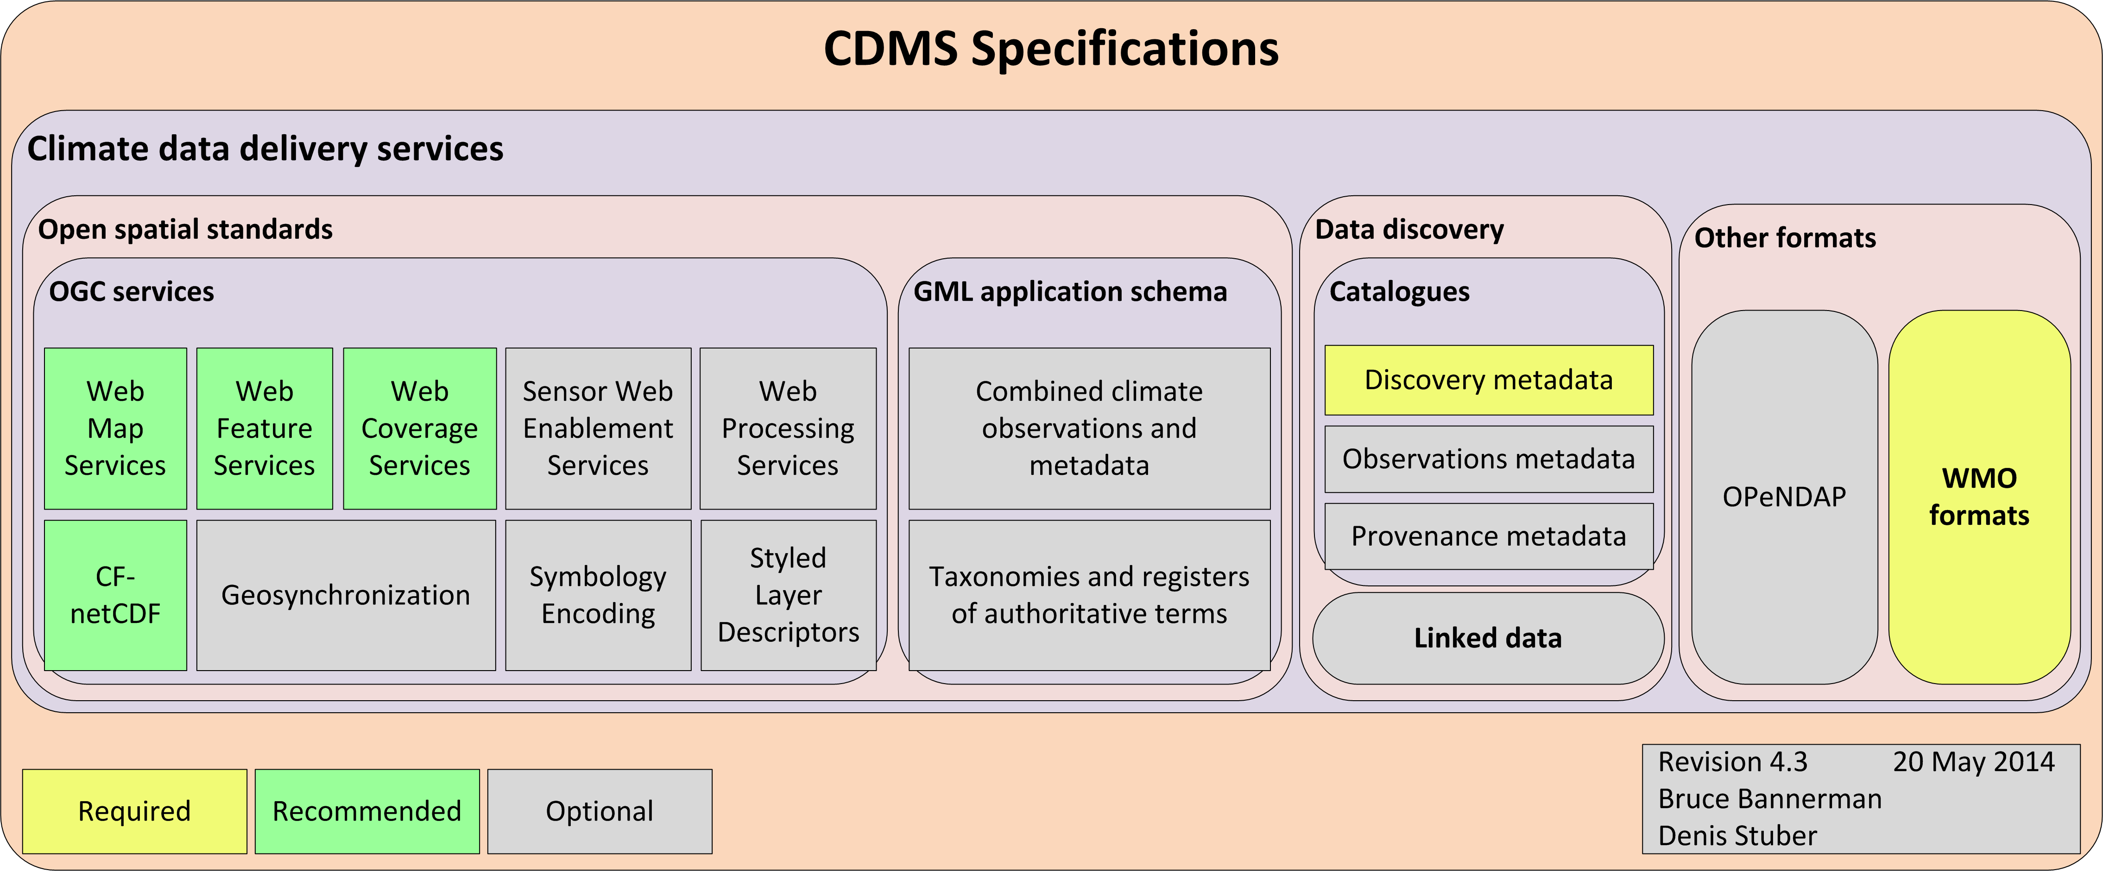
Climate Data Delivery

Slide 17
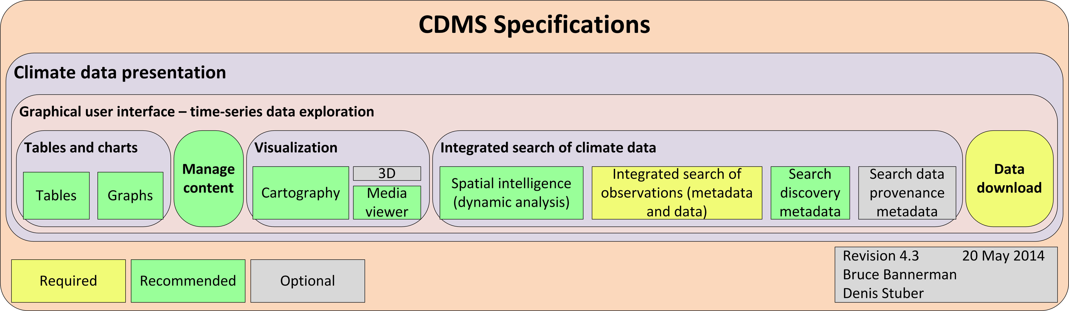
Climate Data Presentation

Slide 18
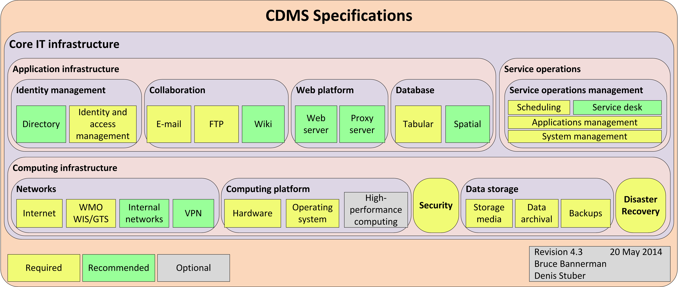
Underlying IT Infrastructure

Slide 19
Proposal

Slide 20
Share the burden
Open-CDMS
Proposal to develop open source CDMS
Next generation CDMS
Conformant with WMO-1131
Developed within the OpenWIS Association framework
not-for-profit
Establish an open source community
to support Open-CDMS in long term
Provide upgrade path for existing CDMS
Develop once, re-use many times

Slide 21
Benefits to WMO Community

Slide 22
Benefits to WMO Community #2

Slide 23
Benefits to NMHS

Slide 24
Benefits to Climate Science

Slide 25
Summary of Benefits
No need for license costs for NMHS
Investment re-used by many NMHS
Consistent CDMS for WMO community:
All have access to the same functionality
All can provide the same products
Establish Open-CDMS community
Transition responsibility for support and maintenance
Robust Governance Process
Open to all interested participants
Good training potential for RCC and perhaps DC
Based on principal of Meritocracy

Slide 26
Why Open Source?
Ensure re-use of investment
Share cost and burden of:
Development
Ongoing Maintenance (of software)
Cost can be $, expertise, willingness to help, etc
Ensure Intellectual Property in CDMS can be re-used
Ensure that software is open for scrutiny and peer review

Slide 27
Open Source ≠ FREE

Slide 28
Funding
We will need significant funding to make this happen
Progress is currently stalled through lack of $
Funding will need to support software development and maintenance
Funding will be required for a number of years (at least 5)
Funding will need to be directed to several NMHS
to facilitate early collaboration
Australian Bureau of Meteorology
Willing to lead the initial development activity
Willing to transition IP and governance to Open-WIS Association

Slide 29
Interest
Currently early days for Open-CDMS
There is increasing interest, e.g.:
Australian Bureau of Meteorology (CliDE, ADAM etc)
UK MetOffice (Climsoft)
WMO CCl
OpenWIS Association
Meteo Suisse (OSCAR data model)
Meteo Moroc
New Zealand NIWA

Slide 30
Current Status March 2016

Slide 31
ICT-CSIS Nov 2015
Strong case made for data management at ICT-CSIS
ICT-CSIS submitted funding bid to GFCS in Dec 2015
5 year funding towards development of Open-CDMS
Led by Australian BoM
In collaboration with peer NMHS
Via OpenWIS Association governance
Including 3 year funding to maintain existing Climsoft, MCH, CliDE
One developer per project
GFCS forwarded bid for consideration by donor agencies
Outlook is uncertain

Slide 32
ET-CDMS Nov 2015
Representatives from ClimSoft, CliDE, MCH
Agreement that we need to transition to Open-CDMS
ET-CDMS released Policy Statement on CDMS
For endorsement by CCl Management Group

Slide 33
ET-CDMS Policy Statement
Annex 4
ET-CDMS notes that:
Currently, significant investment is needed to maintain a multitude of CDMSs worldwide to generate data for regional and global analyses.
These CDMS are not compliant with the new WMO-No.1131, Climate Data Management Systems Specifications.
Significant investment will be required to conform to the requirements of WMO-No. 1131.
It will be very expensive and wasteful of resources to develop the same functionality in many CDMSs.
There are several open source CDMSs used by WMO Members.
There is considerable potential to address this situation by rationalising these open source CDMSs.
Therefore ET-CDMS propose that:
Open source CDMSs should converge on one Reference Open Source CDMS, namely Open-CDMS.
Investment is required to make this happen.

Slide 34
CCl Management Group March 2016
CCl MG have endorsed
ET-CDMS Policy Statement on CDMS
Open-CDMS concept
CCl MG have offered
Further support where possible (budget permitting), and where it will help facilitate appropriate outcomes, e.g.
Expert Teams
Sub Teams
Non-monetary support

Slide 35
Next Steps?
Look for alternate funding opportunities
Wait for a funding source?
Initial Proof of Concept work?
Prove concept
Prove viability
Other?

Slide 36
We need to make Open-CDMS happen

